Slide 1

Notes:
‹#›
‹#›

Slide 2

Sentiment Analysis from text feedback
Team Name: Akatsuki
Team Members:
Deepak Mulwani
Yash Gurnani
Nikhil Gaikwad
Kartik Chindarkar
Prajakta Gole
Himanshu Pingulkar
Notes:
‹#›
‹#›

Slide 3
Overview:
Introduction
Objective
Proposed System (Block diagram)
Technology
Working
Analysis
Conclusion

Slide 4
Introduction
As any organization, the company always look for knowing how the people feel about their product. Users provide the review or comments for product's feedback.
Sentiment Analysis works on the principle of Natural Language Processing by analysing the reviews/comments or feedback of users according to their sentiments given in rating.
Their can be a lot of reviews from users for a certain product and hence the dataset will vary accordingly.
Here, we are building an website application to analyze the dataset of reviews of any organization concerning any product and provide an overall feedback for that product according to the user's provided reviews and ratings.

Slide 5
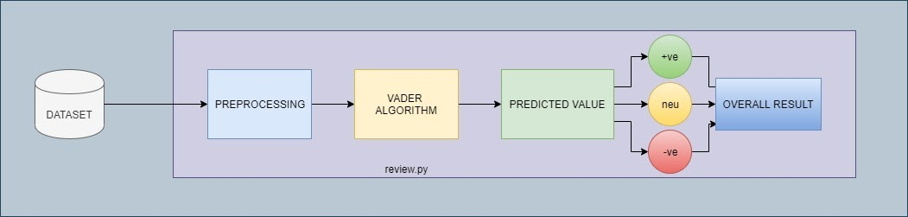
Proposed Model
Our project contains the following steps
Cleaning of data
If any review is in another language, then translating into English language
Cleaned data is passed onto VADER algorithm
The algorithm provides polarity based results which are classified as Positive, Negative and Neutral of individual review
And hence, provides an overall review for that certain dataset chosen of any product

Slide 6
Objectives
This project is build across the idea of using technology for analyzing sentiments in user's reviews which is present in dataset.
Analyze Individual review/rating in terms with polarity i.e positive, negative and neutral responses.
Translate any other language in English language.
Analyze through overall rating with Pie-Chart for better graphical representation.

Slide 7
Technology Stack
Programming language : Python
Technology : Natural Language Processing(NLP)
Libraries: vaderSentiment, Google translate
Framework : Django

Slide 8
Working
User will login at first.
After successful login, the user will upload the dataset for analyzing reviews.
User can also lookup for the previous files which were used for analyzing in History section.
After successful upload, user can view the individual comments in that section
User can also look for Pie Chart for overall analysis of the selected dataset.

Slide 9
Analysis
Our proposed Model will consume only dataset which is supposed to be analyzed, thus it fulfils the most important requirement.
By using the above system, organization will realize how the ratings and reviews are given by the customers for that product and hence can look how much the product is more positive, negative or neutral.
And also, can directly view the chart for the organization's dataset for that product.

Slide 10
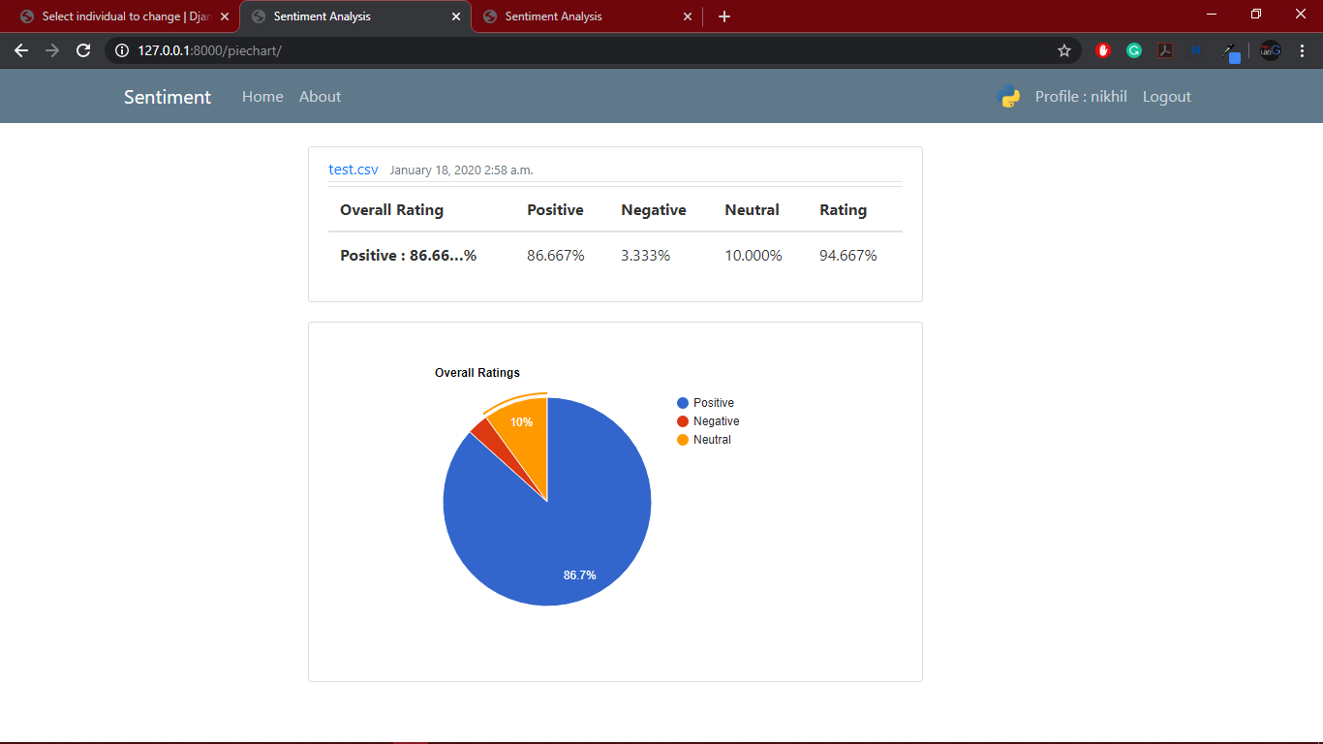
Analysis (Cont.)

Slide 11
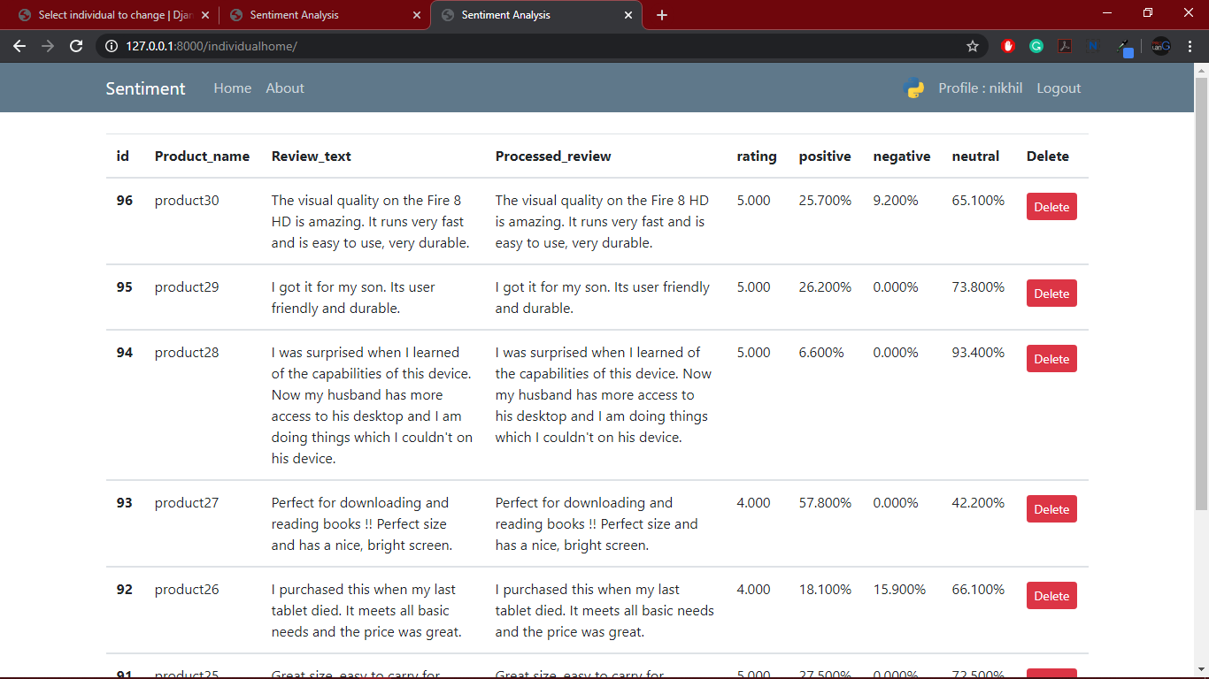
Analysis (Cont.)

Slide 12
Conclusion
With this idea or model of checking and analyzing the reviews the product feedback can be recognized by organization. According to the product feedback after analyzing, an organization can take measurable steps.
Thus our project was successfully designed,implemented and tested.

